Slide 1
MySQL and Assignment

Slide 2
Areas of focus
Creating database
Writing SQL query and execution
SQL query debugging
Creating EER Diagram
Understanding relationships
Identifying primary and foreign key

Slide 3
Database
You will work on with “world” database from mysql website resources. Please refer to the link to learn more about this database.
Link: https://dev.mysql.com/doc/world-setup/en/
Please read Preface and Legal Notices.

Slide 4
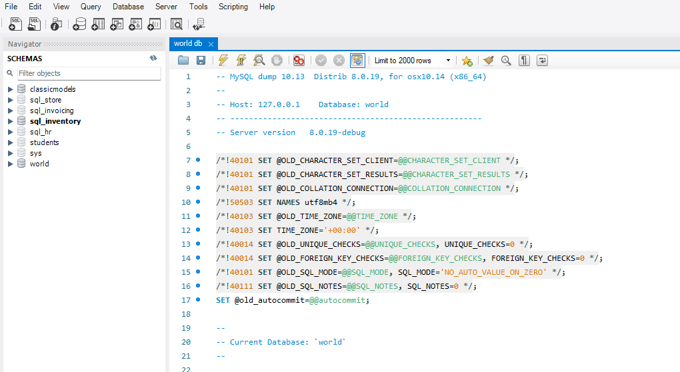

Import and Execute
Import SQL Script “world db” and then execute the script. Refresh schemas and check if db “world” exits.

Slide 5
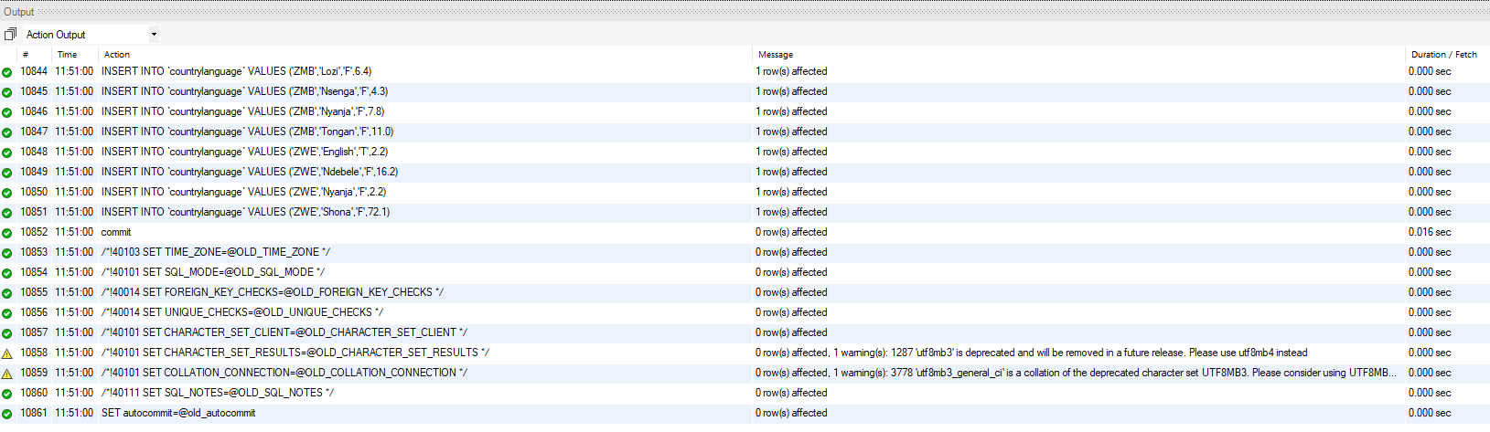
Once executed you will see the below actioned Output

Slide 6
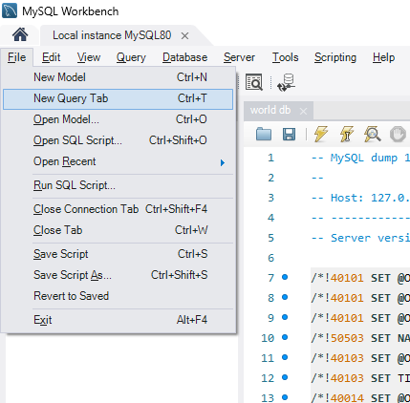
New Query Tab
On your keyboard hold down Ctrl and T keys to open new query tab.
Or you can do it from task bar

Slide 7
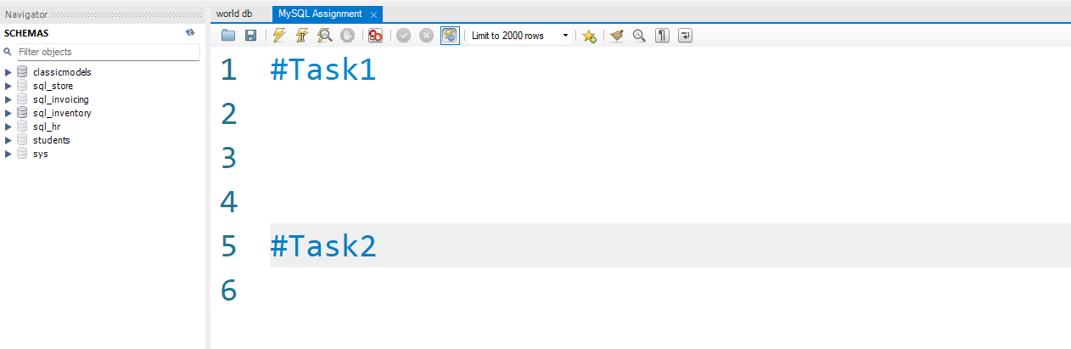
Saving Task and Queries
Use # key to comment your tasks. You will need to save this query tab for trainers review later. Please use same query tab for all your tasks.

Slide 8
Task 1
Using count, get the number of cities in the USA

Slide 9
Task 2
Find out what the population and average life expectancy for people in Argentina (ARG) is

Slide 10
Task 3
Using ORDER BY, LIMIT, what country has the highest life expectancy?

Slide 11
Task 4
Create a SQL statement to display columns Id, Name, Population from the city table and limit results to first 10 rows only.

Slide 12
Task 5
Create a SQL statement to find only those cities from city table whose population is larger than 2000000.

Slide 13
Task 6
Create a SQL statement to find only those cities from city table whose population is between 500000-1000000.

Slide 14
Task 7
Create a SQL statement to find a city with the lowest population in the city table.

Slide 15
Creating an EER Diagram

Slide 16
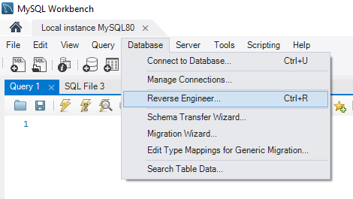

Slide 17
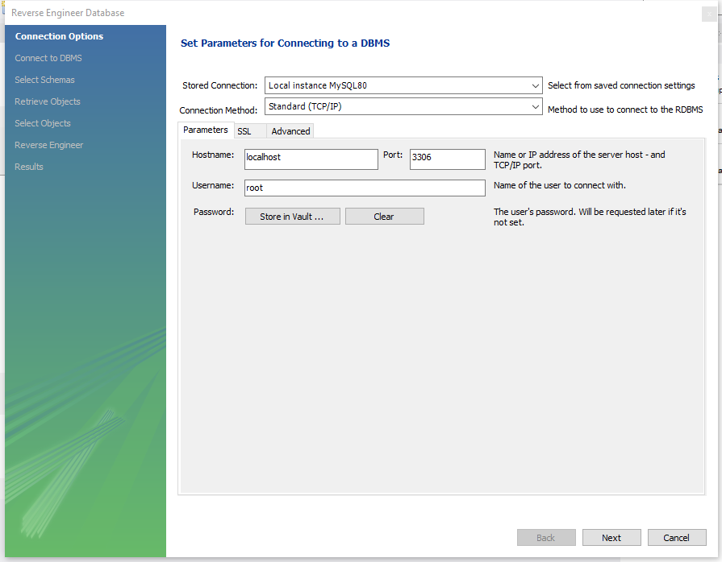

Slide 18
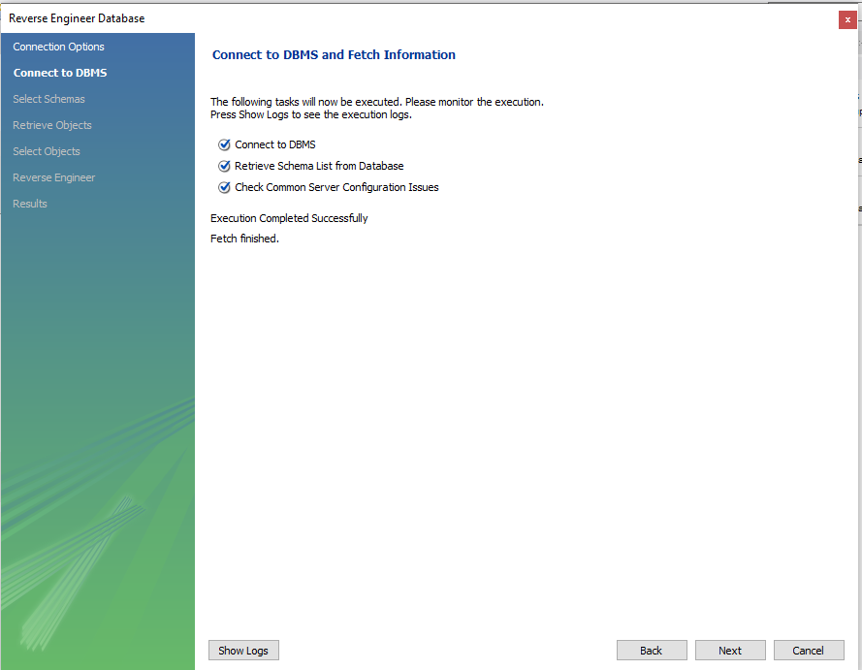

Slide 19
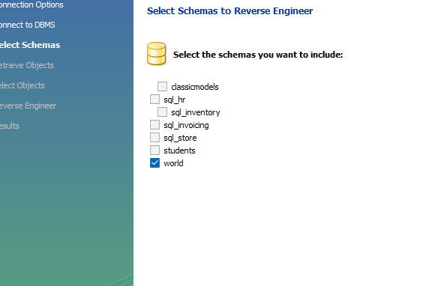
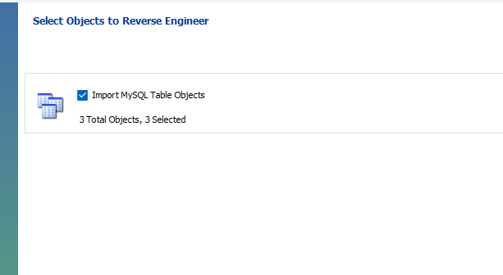

Slide 20
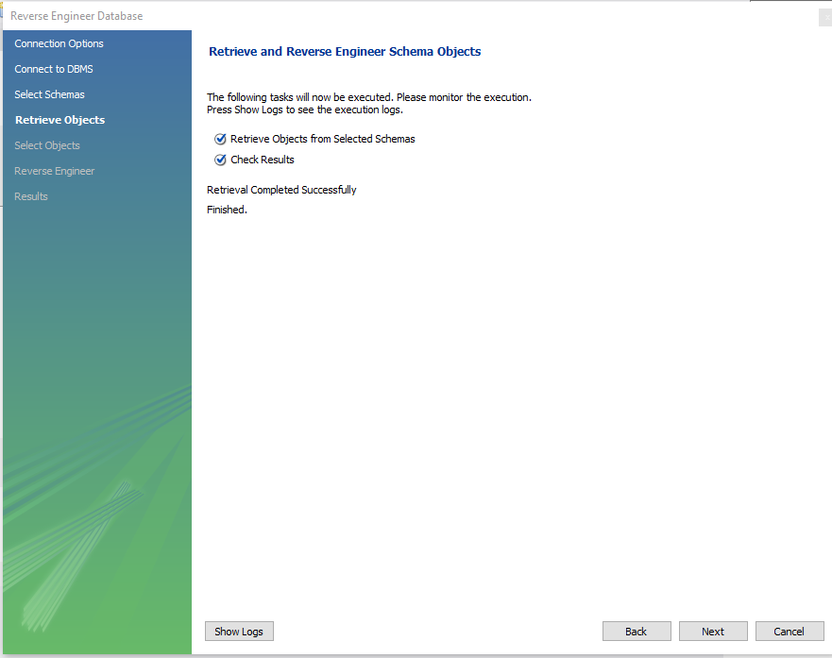

Slide 21
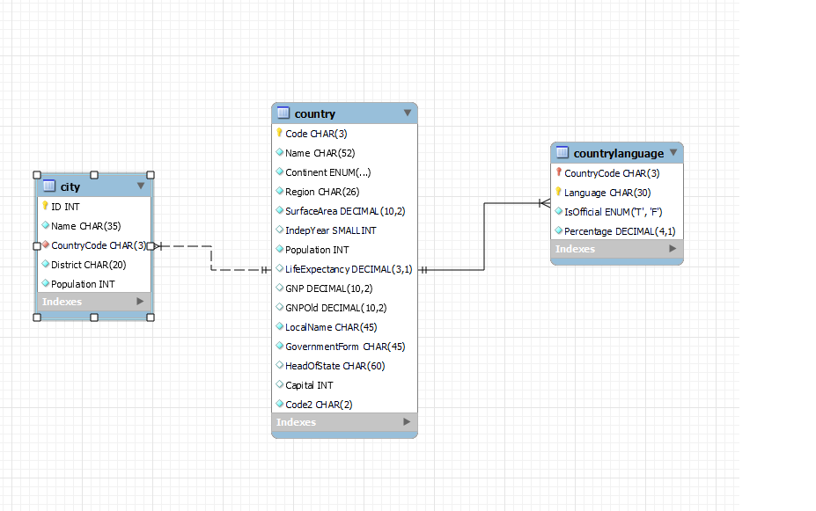

Slide 22
Task 7
Answer the following:
Identify the primary key in country table.
Identify the primary key in city table.
Identify the primary key in countrylanggage table.
Identify the foreign key in city table.
Identify the foreign key in countrylanggage table.

